Slide 1
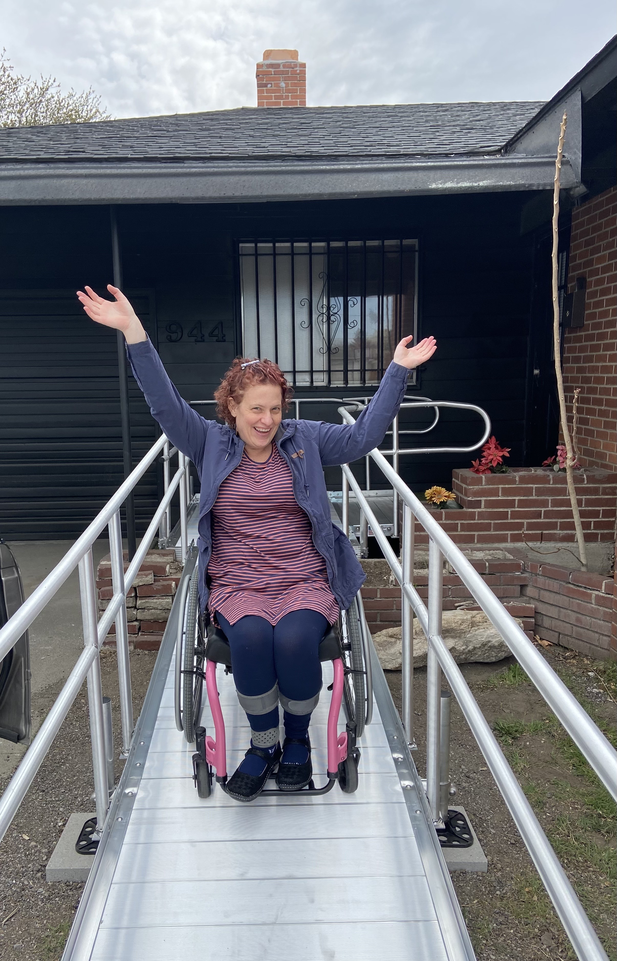
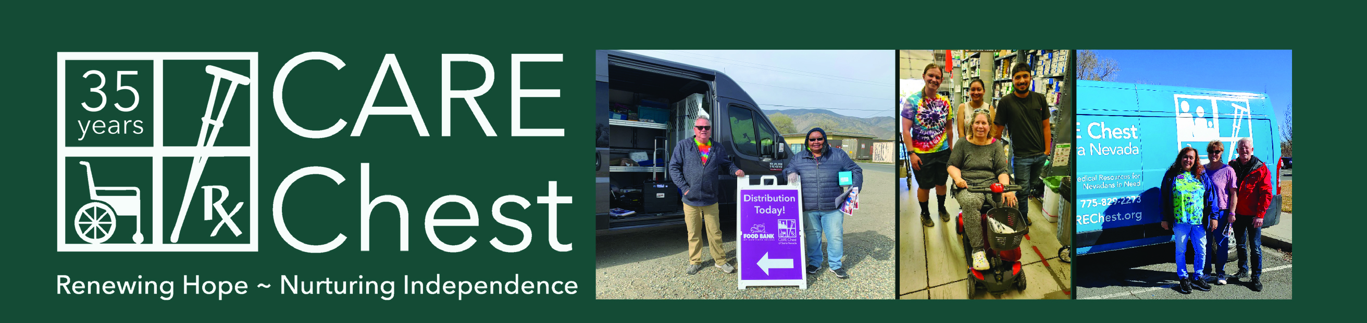
CARE = "Community Assistance Resource Endowment”
Mission Statement: CARE Chest is a Nevada nonprofit agency serving individuals in need by providing medical resources, free of charge.
Vision Statement: CARE Chest continually improves the quality of life of individuals in need by setting the standard in providing comprehensive medical resources and services.
Key Values: In every interaction, CARE Chest values open communication, compassion, accountability and efficiency.

Slide 2
Medical Equipment & Supplies
Medical Equipment and Supplies: Durable medical equipment is loaned as needed, and single-use supplies can be reordered monthly for eligible consumers. If individuals do not qualify due to their monthly income being too high, they may enroll in Club CARE Chest for an annual fee of $50. 13,880 individuals were served last year; 15,684 are projected to be served in the year ahead.
2026 Updates: Due to increased community demand for incontinence protection CARE Chest was forced to spend 10% over the already significant projected increase for 2026.
FY26 Stats:
Current Individuals Served:
14,498
Demographic of Consumers:
Caucasian: 49.5%
Hispanic: 27.2%
African-American: 11.7%
Asian: 5.1%
Other: 2.7%
Native American: 2.4%
Pacific Islander: 0.8%
Multi-Racial: 0.4%
Middle Eastern: 0.3%

